Slide 1
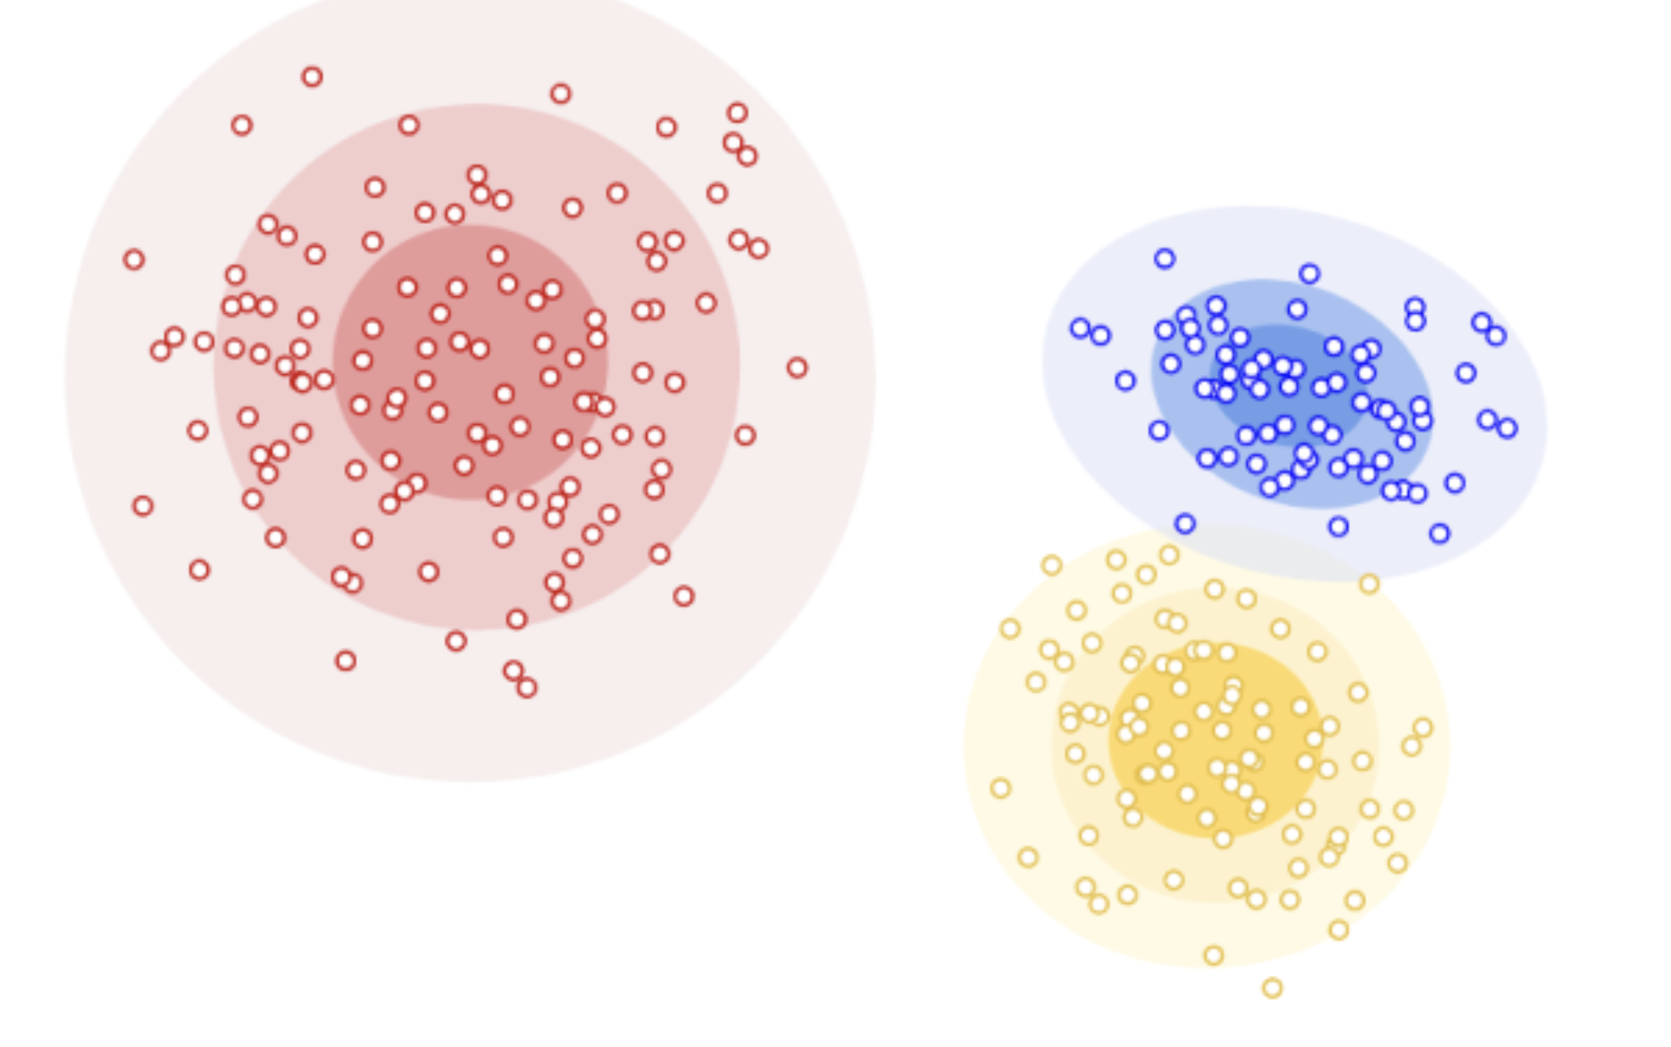
Welcome to Section 7
Clustering
16th May, 2024
Haedong Yonggungsa Temple, S. Korea

Slide 2
Administrivia
Monday: Learning Reflection 7 due
Today: HW5 Due

Slide 3
Agenda
HW6 Overview & Useful Numpy Functions
Clustering
Embedding: TF-IDF, Word2Vec
K-means Clustering
Hierarchical Clustering
Agglomerative Clustering

Slide 4
HW6 Overview: Implement and use k-means
Part1: Implement K-means
Q1: Computing Distances between all the points and initial centroids
Q2: Find closest centroid
Q3: Assign Clusters for each point
Q4: Revise Centroids: calculate the new centroid within each cluster
Q5: Combining it into a single function
Part2: Use K-means
Q6: Largest cluster
Q7: k-means_multiple_runs
Q8: Small clusters

Slide 5
Useful Numpy functions
np.array(object: array_like)
Create an array.
Eg. np.array([[1, 2], [3, 4]])
np.zeros(shape: int or tuple of ints)
Return a new array of given shape and type, filled with zeros.
~.shape
Get shape of numpy array
np.argmin(a: array_like, axis=None), np.argmax(a: array_like, axis=None)
Returns the indices of the minimum/maximum values along an axis.
np.sum(a: array_like, axis=None)
Sum of array elements over a given axis.
ndarray.min(), ndarray.max()
Return the minimum/maximum along a given axis.
np.bincount(x: array_like)
Count number of occurrences of each value in array of non-negative ints.
Notes:
–BRIEFLY TALK–

Slide 6
Clustering
Unsupervised form of learning (no labeled data!)
Makes use of embedding and distance
Embedding: Turning data into a vector of continuous numbers
Distance: Measurement of how far apart two data points are
Putting data points into discrete groups or “clusters” based on a distance metric
Notes:
High level overview of clustering

Slide 7
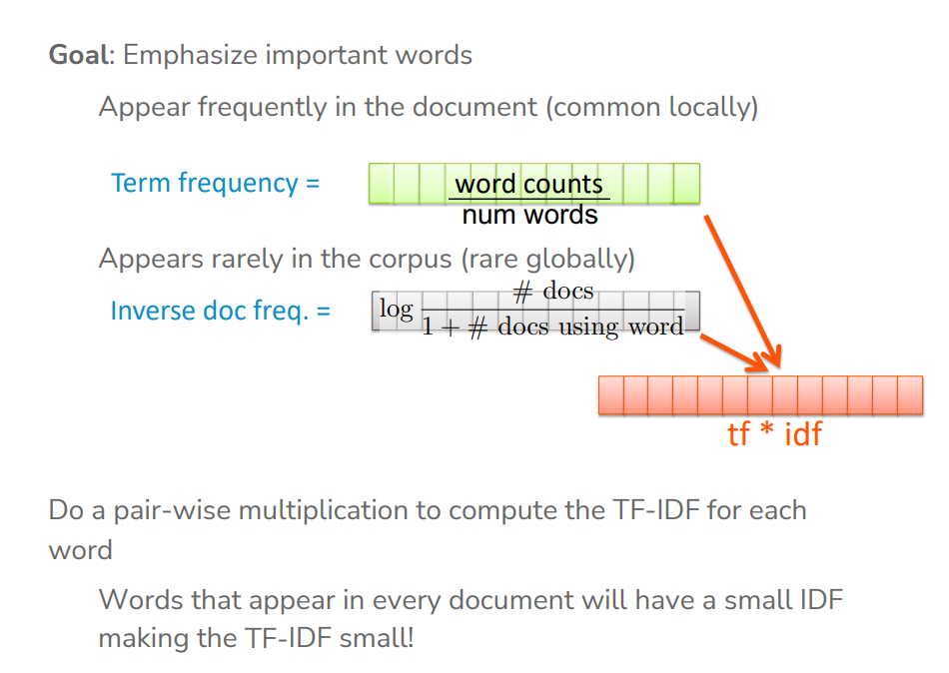
Embedding documents by TF-IDF
Notes:
Before TF-IDF, learned about bag of words
What is bag of words?
How do you embed a document with TF-IDF?
TF = word count/num words
IDF = log(#docs / 1 + # docs using word)
TF * IDF -> vector

Slide 8
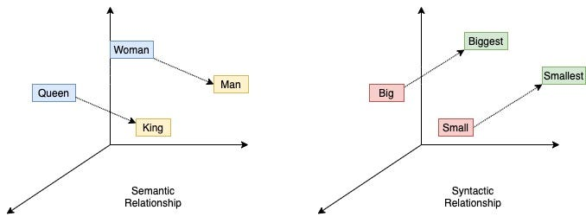
Embedding words by word2vec
Word2Vec: neural-network based word embedding
Pros: seems to learn something about semantic meaning
Cons: no guarantees :)
Word2Vec Explained!
Notes:
Note that Word2Vec is a word embedding. To get a document embedding, you can either average the words present in the document (equivalent to multiplying the word embeddings by the TF matrix), or multiply the word embedding by the TF-IDF matrix (to prevent common words form dominating)
Word2Vec examples:
Similar words
Similarity
Analogy:
king, queen, actor
king, queen, doctor

Slide 9
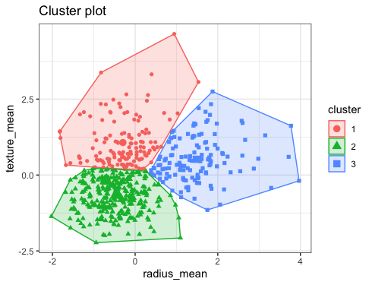
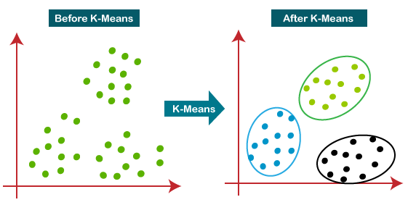
K-means clustering
Big idea: Iteratively divide the data up into K groups of equal variance
Step 1: Assign each data point to the closest of K centroids
Step 2: Move each centroid to the mean position of the data assigned to it
Repeat until convergence!
Notes:
Randomly choose data points as centroids
Assign each data point a cluster based on its proximity to the cluster’s centroid
Shift the previous centroid to the position that is the mean of all the data points in the cluster
Repeat until convergence
Cluster assignments didn’t change
Centroids didn’t change
Past max threshold

Slide 10
K-means clustering
What convergence is guaranteed with K-means?
Global optimum
Local optima
None
Notes:
Randomly choose data points as centroids
Assign each data point a cluster based on its proximity to the cluster’s centroid
Shift the previous centroid to the position that is the mean of all the data points in the cluster
Repeat until convergence
Cluster assignments didn’t change
Centroids didn’t change
Past max threshold

Slide 11
K-means clustering
What convergence is guaranteed with K-means?
Global optimum
Local optima
None
What does this mean?
Initialization greatly affects final clusters.
Notes:
Randomly choose data points as centroids
Assign each data point a cluster based on its proximity to the cluster’s centroid
Shift the previous centroid to the position that is the mean of all the data points in the cluster
Repeat until convergence
Cluster assignments didn’t change
Centroids didn’t change
Past max threshold

Slide 12
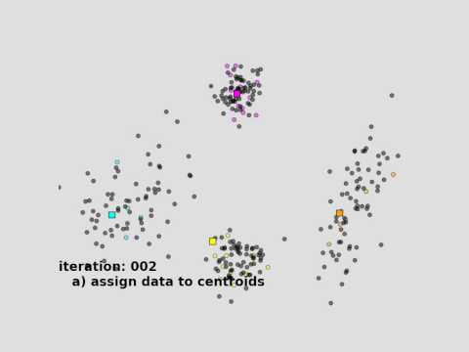

Slide 13
Initializing Centroids
Easy method: Random initial centroids
Could get stuck in a bad local optimal
Smarter (but harder) method: Place centroids far away from each other (k-means++)
P(centroid placed at x_{i}) ∝ distance to nearest centroid^2
Notes:
–DRAW ON BOARD–
– Greater distance, higher probability of x_i being chosen as the centroids

Slide 14
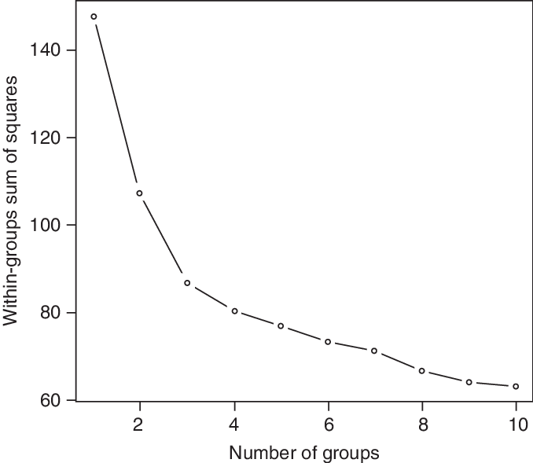

Finding k for K-means
Based on the graph, what number of clusters (K) is most optimal?
Hint:
Notes:
Answer: 3
Find the elbow!

Slide 15
Finding k for K-means
Based on the graph, what number of clusters (K) is most optimal?
Hint:
Notes:
Answer: 3

Slide 16
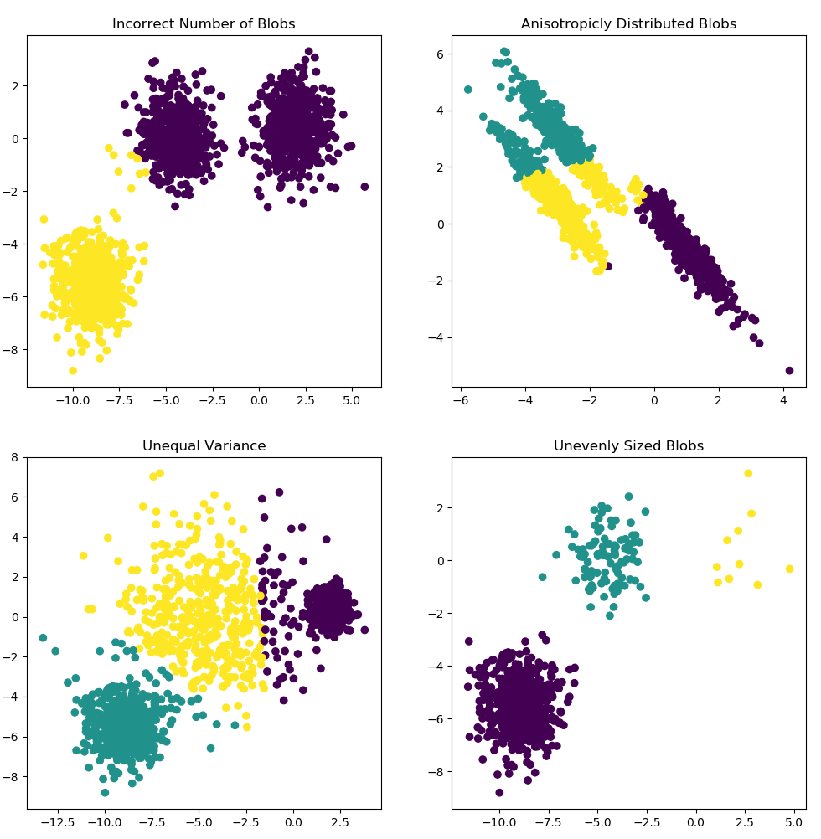
K-means is not free lunch!
K-means assumes variance of the distribution of each feature is spherical (Euclidean distance)
All variables have the same variance (homogeneity)
Each cluster has roughly equal number of variance
Notes:
Disparate cluster sizes
Overlapping clusters
Differently shaped/oriented clusters

Slide 17
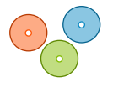
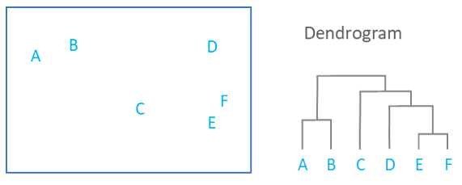
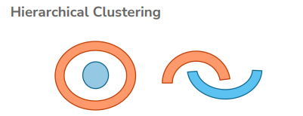
Hierarchical Clustering
Spherical clusters may not accurately describe the underlying structure of the data...
Hierarchical clustering learns more flexible cluster shapes by linking smaller clusters together (agglomerative) or dividing larger clusters (divisive)
No need to choose “K” beforehand
Can use distance metrics other than Euclidean

Slide 18
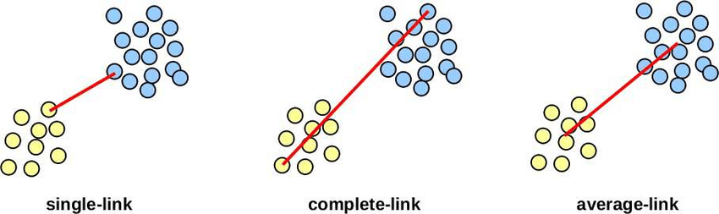
Agglomerative Clustering
Start with every data point in its own cluster
Iteratively combine the two closest clusters into one (and add it to the dendrogram)
Different metrics of distance between clusters
Single linkage: Minimum distance between points in the two clusters
Complete linkage: Maximum distance between points in the two clusters
Centroid linkage: Distance between mean points in the two clusters
Notes:
One method of hierarchical clustering is agglomerative clustering
The other is divisive clustering

Slide 19
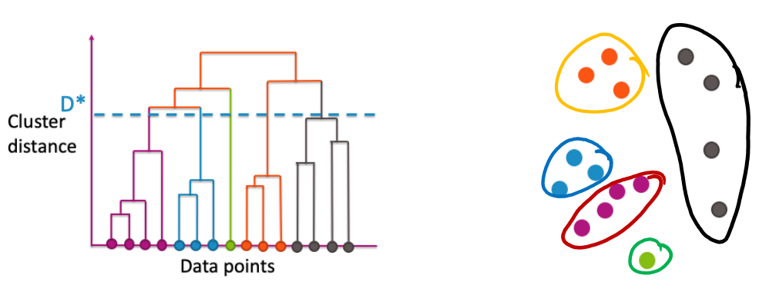
Agglomerative Clustering
Build up a dendrogram representing which clusters combined and when
“Cut” dendrogram at a certain height to get desired number of clusters
5 clusters

Slide 20
Practice Questions
1. Which has better computational complexity?
2. Which has more hyperparameters?
K-means or Agglomerative Clustering
Notes:
Answers: 1) K-means but an argument could be made that they are the same (best agg. Clustering is O(n^2))
2) Open-ended (K-means has K, initialization strategy, possibly # iterations. Agg. has distance metric, linkage type, cluster threshold)
O(n * k * i * d)
O(n^2 * d)

Slide 21
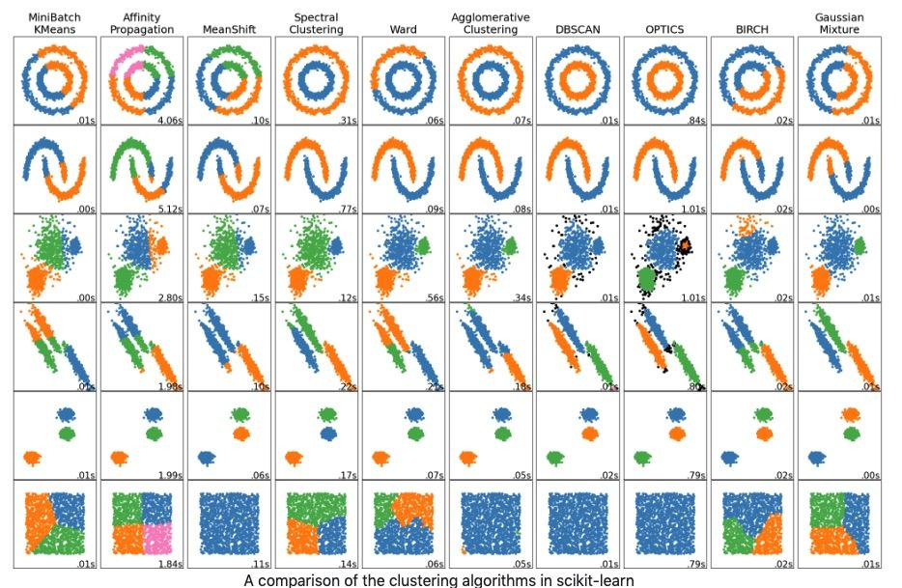
There Are MANY Clustering Algorithms – we are just scratching the surface (you don’t need to know these)

Slide 22
Practice Problems

Slide 23
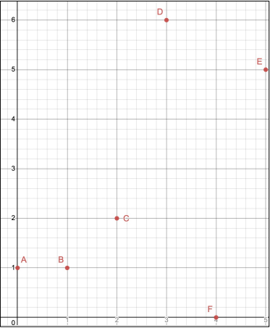
In what order will the following points get merged into clusters? Use Euclidean distance + complete linkage
Notes:
AE, DAE, BDAE, FBDAE, CFBDAE,

Slide 24
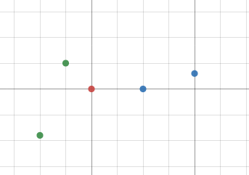
centroids
k = 2
We want two clusters. What are the final cluster assignments here?

Slide 25
centroids
k = 2
We want two clusters. What are the final cluster assignments here?

Slide 26
Edstem Demo
https://edstem.org/us/courses/56859/lessons/98878/slides/546901

